Slide 1
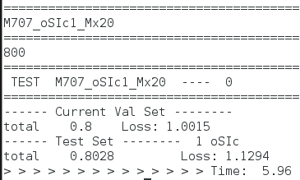
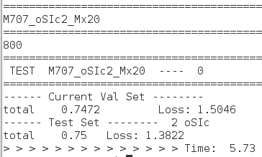
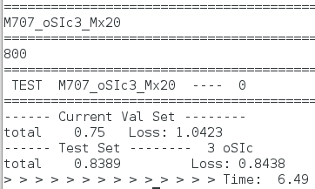
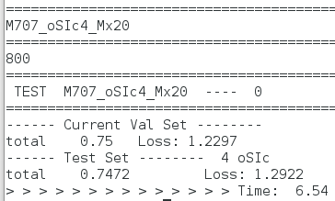
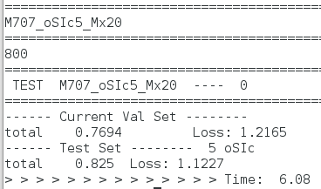
Single view - Model 707

Slide 2
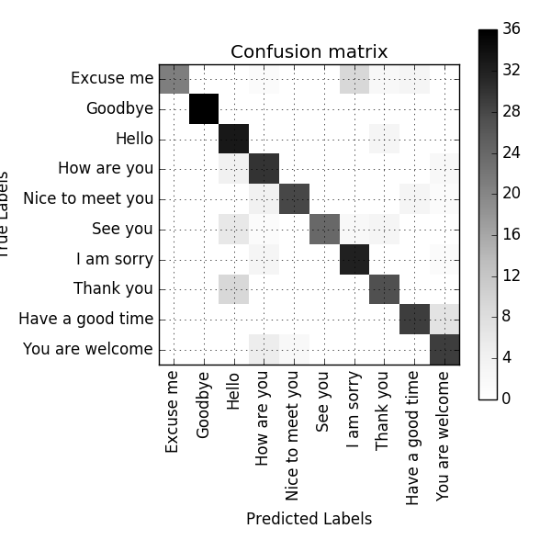
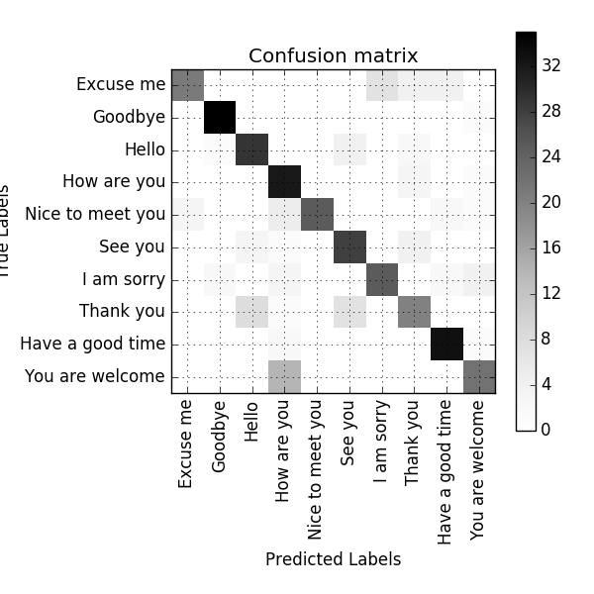
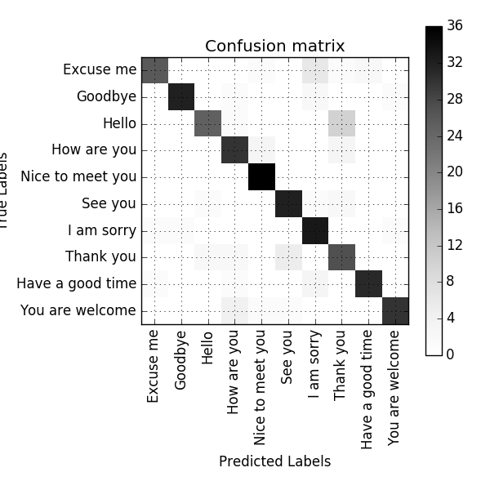
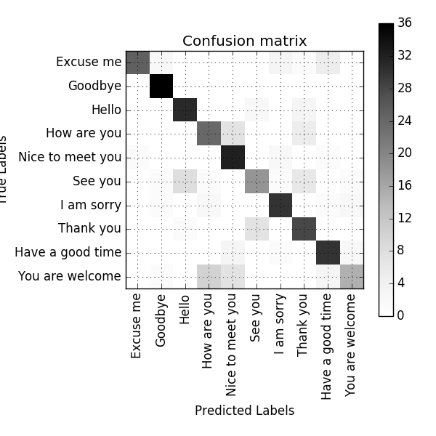
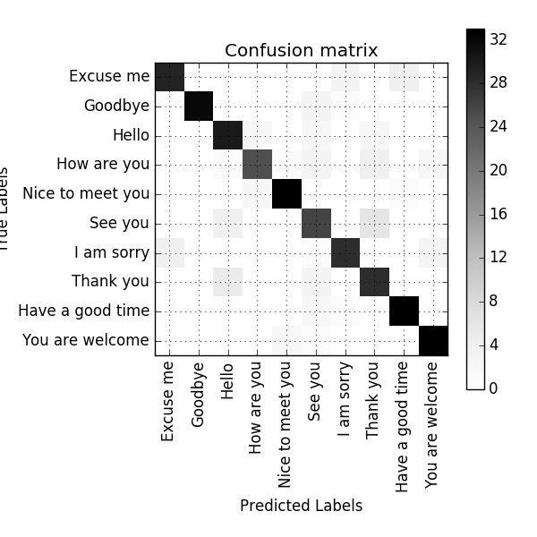
Single view - Model 707

Slide 3





Single view - Model 704

Slide 4
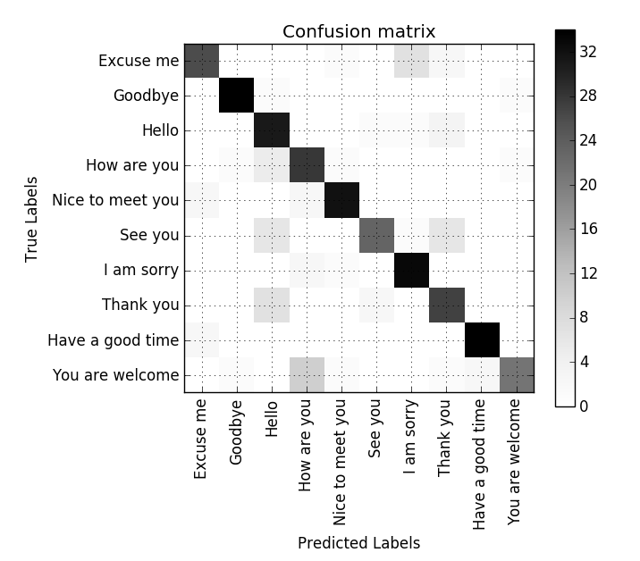
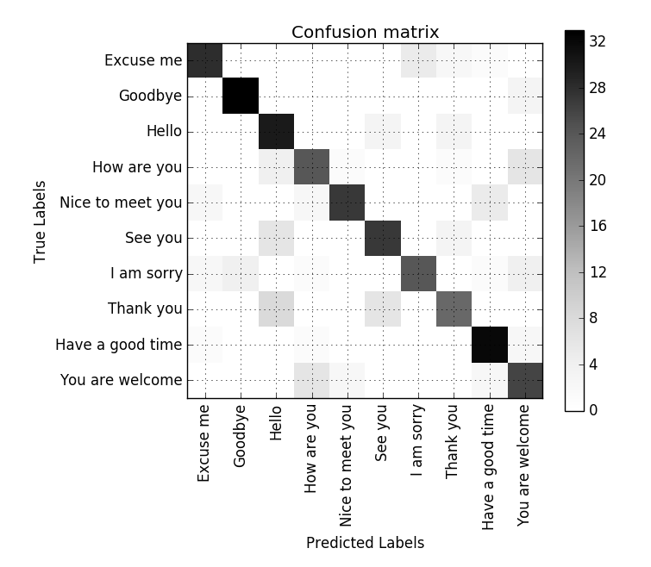
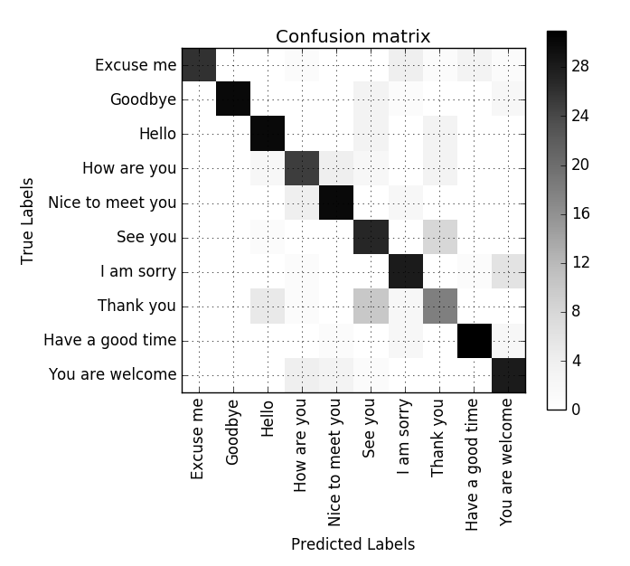
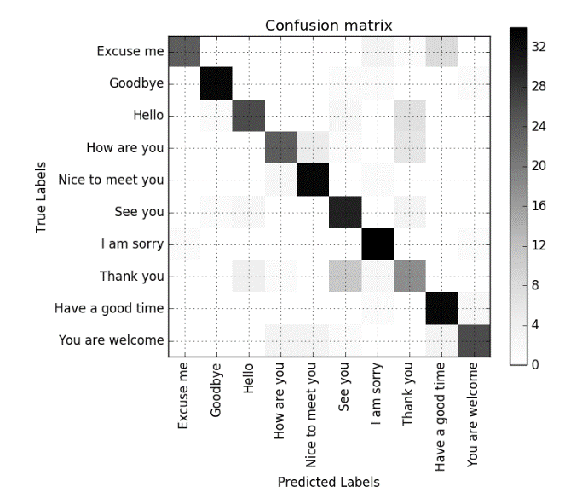
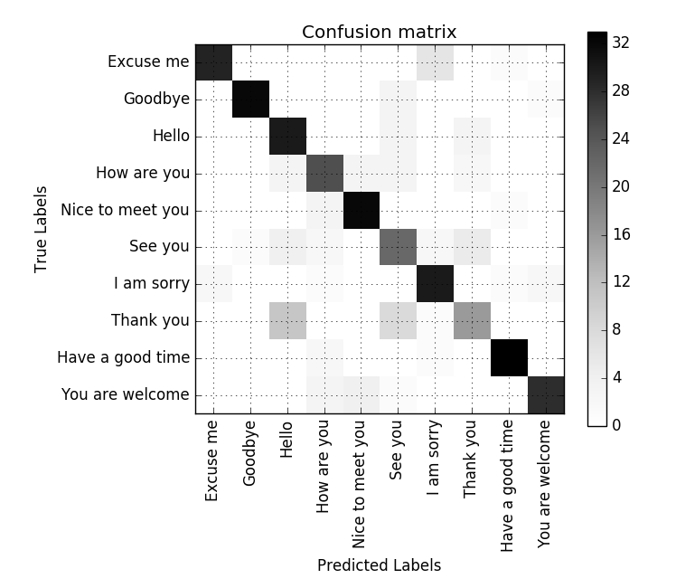
Single view - Model 704

Slide 5




Multi view

Slide 6
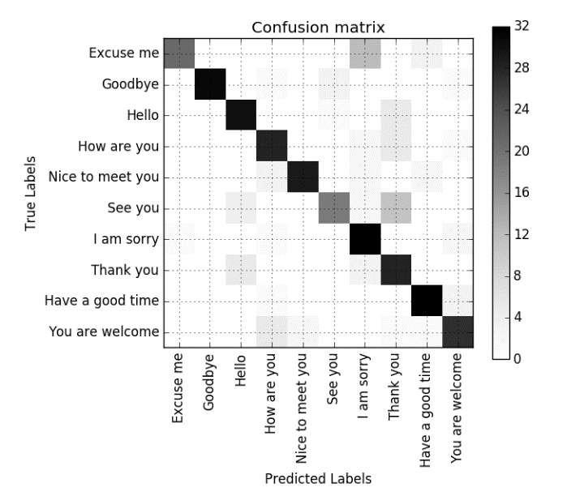
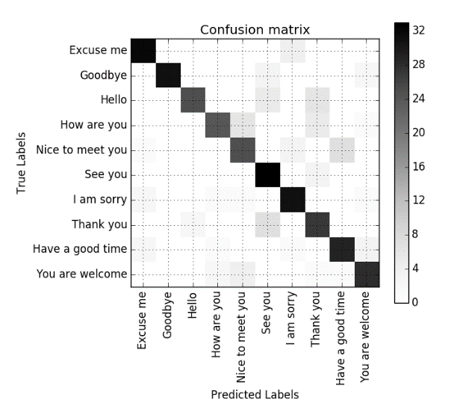
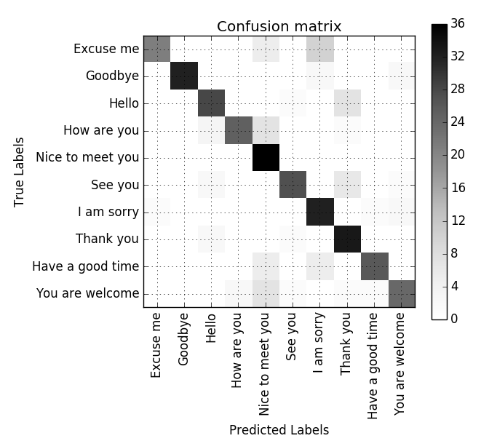
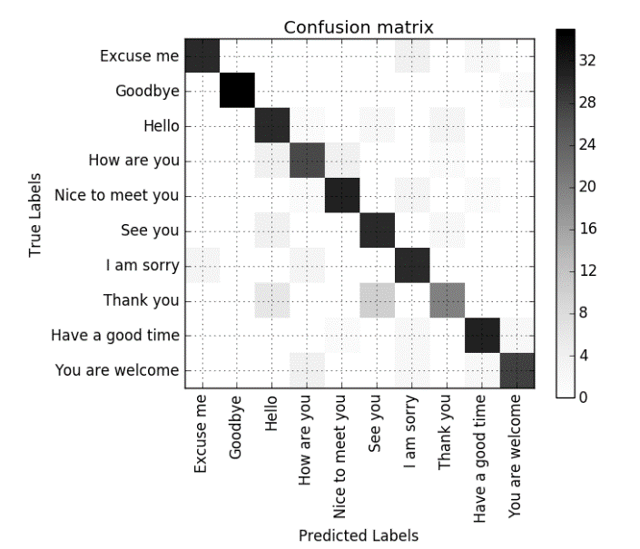
Multi view

Slide 7
Single view | Frontal | 30 | 45 | 60 | Profile | Average
Original | 81.1% | 80% | 76.9% | 69.2% | 82.2% | 77.9%
Bi-LSTM | - | - | 83.89% | 75.83% | 82.5% | 80.66%
Multi view | 3D-CNN | Merge Channels | Merge Images | Merge Features
Original | 76.1% | 78.9% | 80.0% | 79.4%
Bi-LSTM | 76.94% | 79.17% | - | 81.11%
Data augmentation | 77.29% | 79.36% | 82.12% | 81.25%
Bi-LSTM + Data augmentation | 78.30% | - | - | 81.85%

